Slide 1

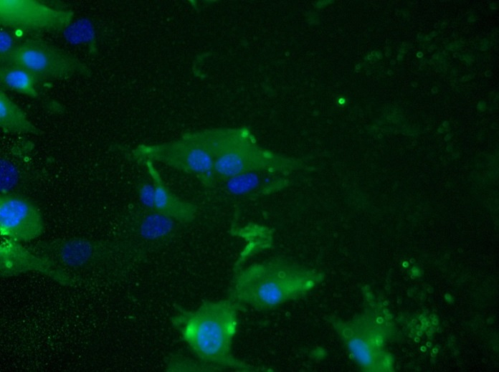
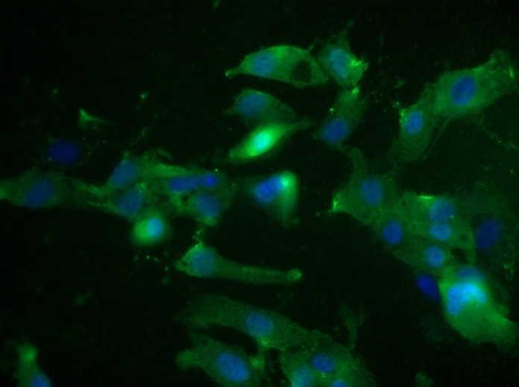
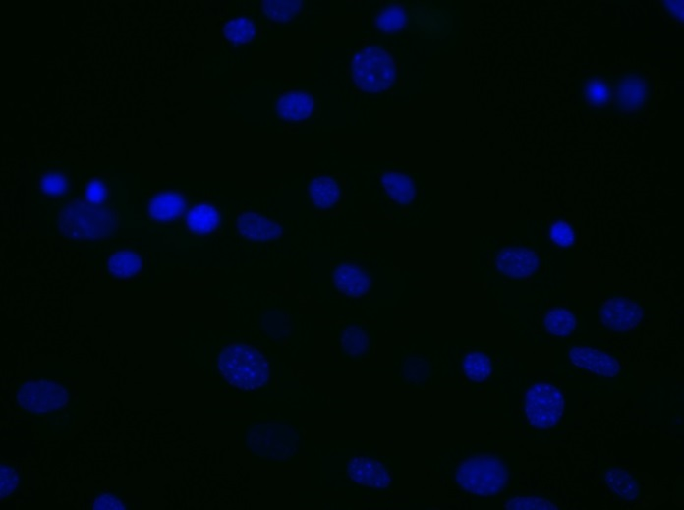
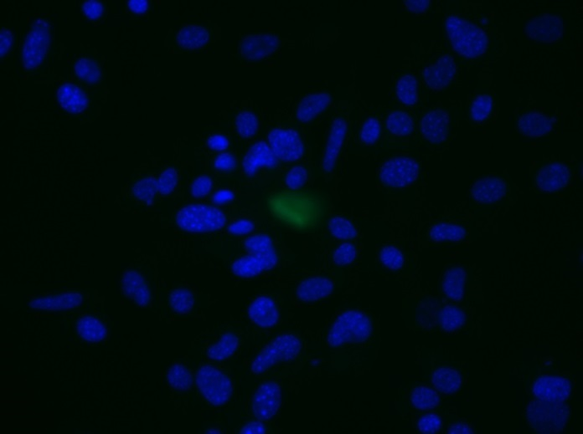
Reliatech GmbH
Rat anti-mouse VEGFR-3/FLT-4
(Cat# 103-M36 [10 µg/ml]; SnoMec)
Immunofluorescence staining of mouse VEGFR-3/FLT-4 (#103-M36) in primary mouse endothelial cells (SnoMec) using a monoclonal antibody directed against the extracellular domain of mouse FLT-4.
As secondary antibody goat anti-rat ALEXA Flour 488 (Dianova; 1:600) was used.
[IF_mEC1407-02]
.
rat anti-mouse FLT4
rat anti-mouse FLT4
Control (goat anti-rat IgG ALEXA Flour 488; 1:600)
http://www.reliatech.de / orders@reliatech.de

